Slide 1
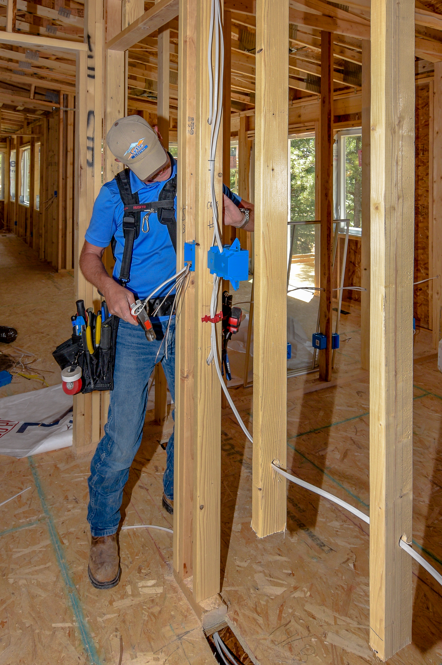

GREAT NEWS
We have
Check us out on Amazon

Slide 2
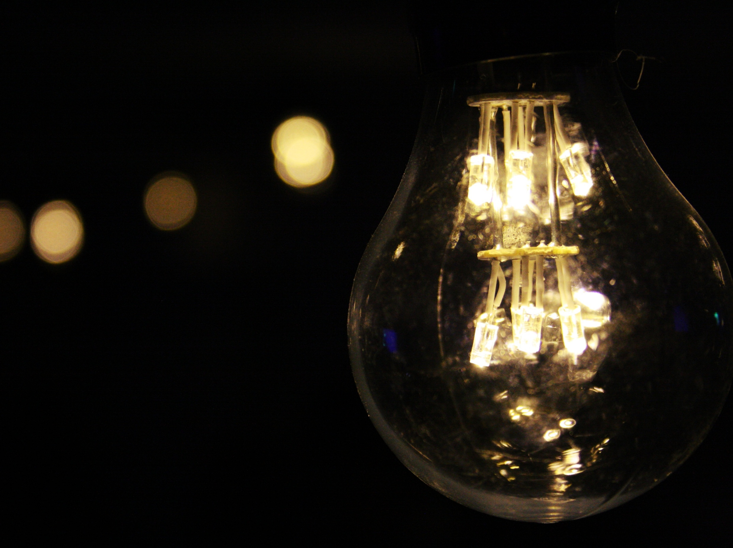


“There are darknesses in life and there are lights, and you are one of the lights, the light of all lights.” ― Bram Stoker

Slide 3
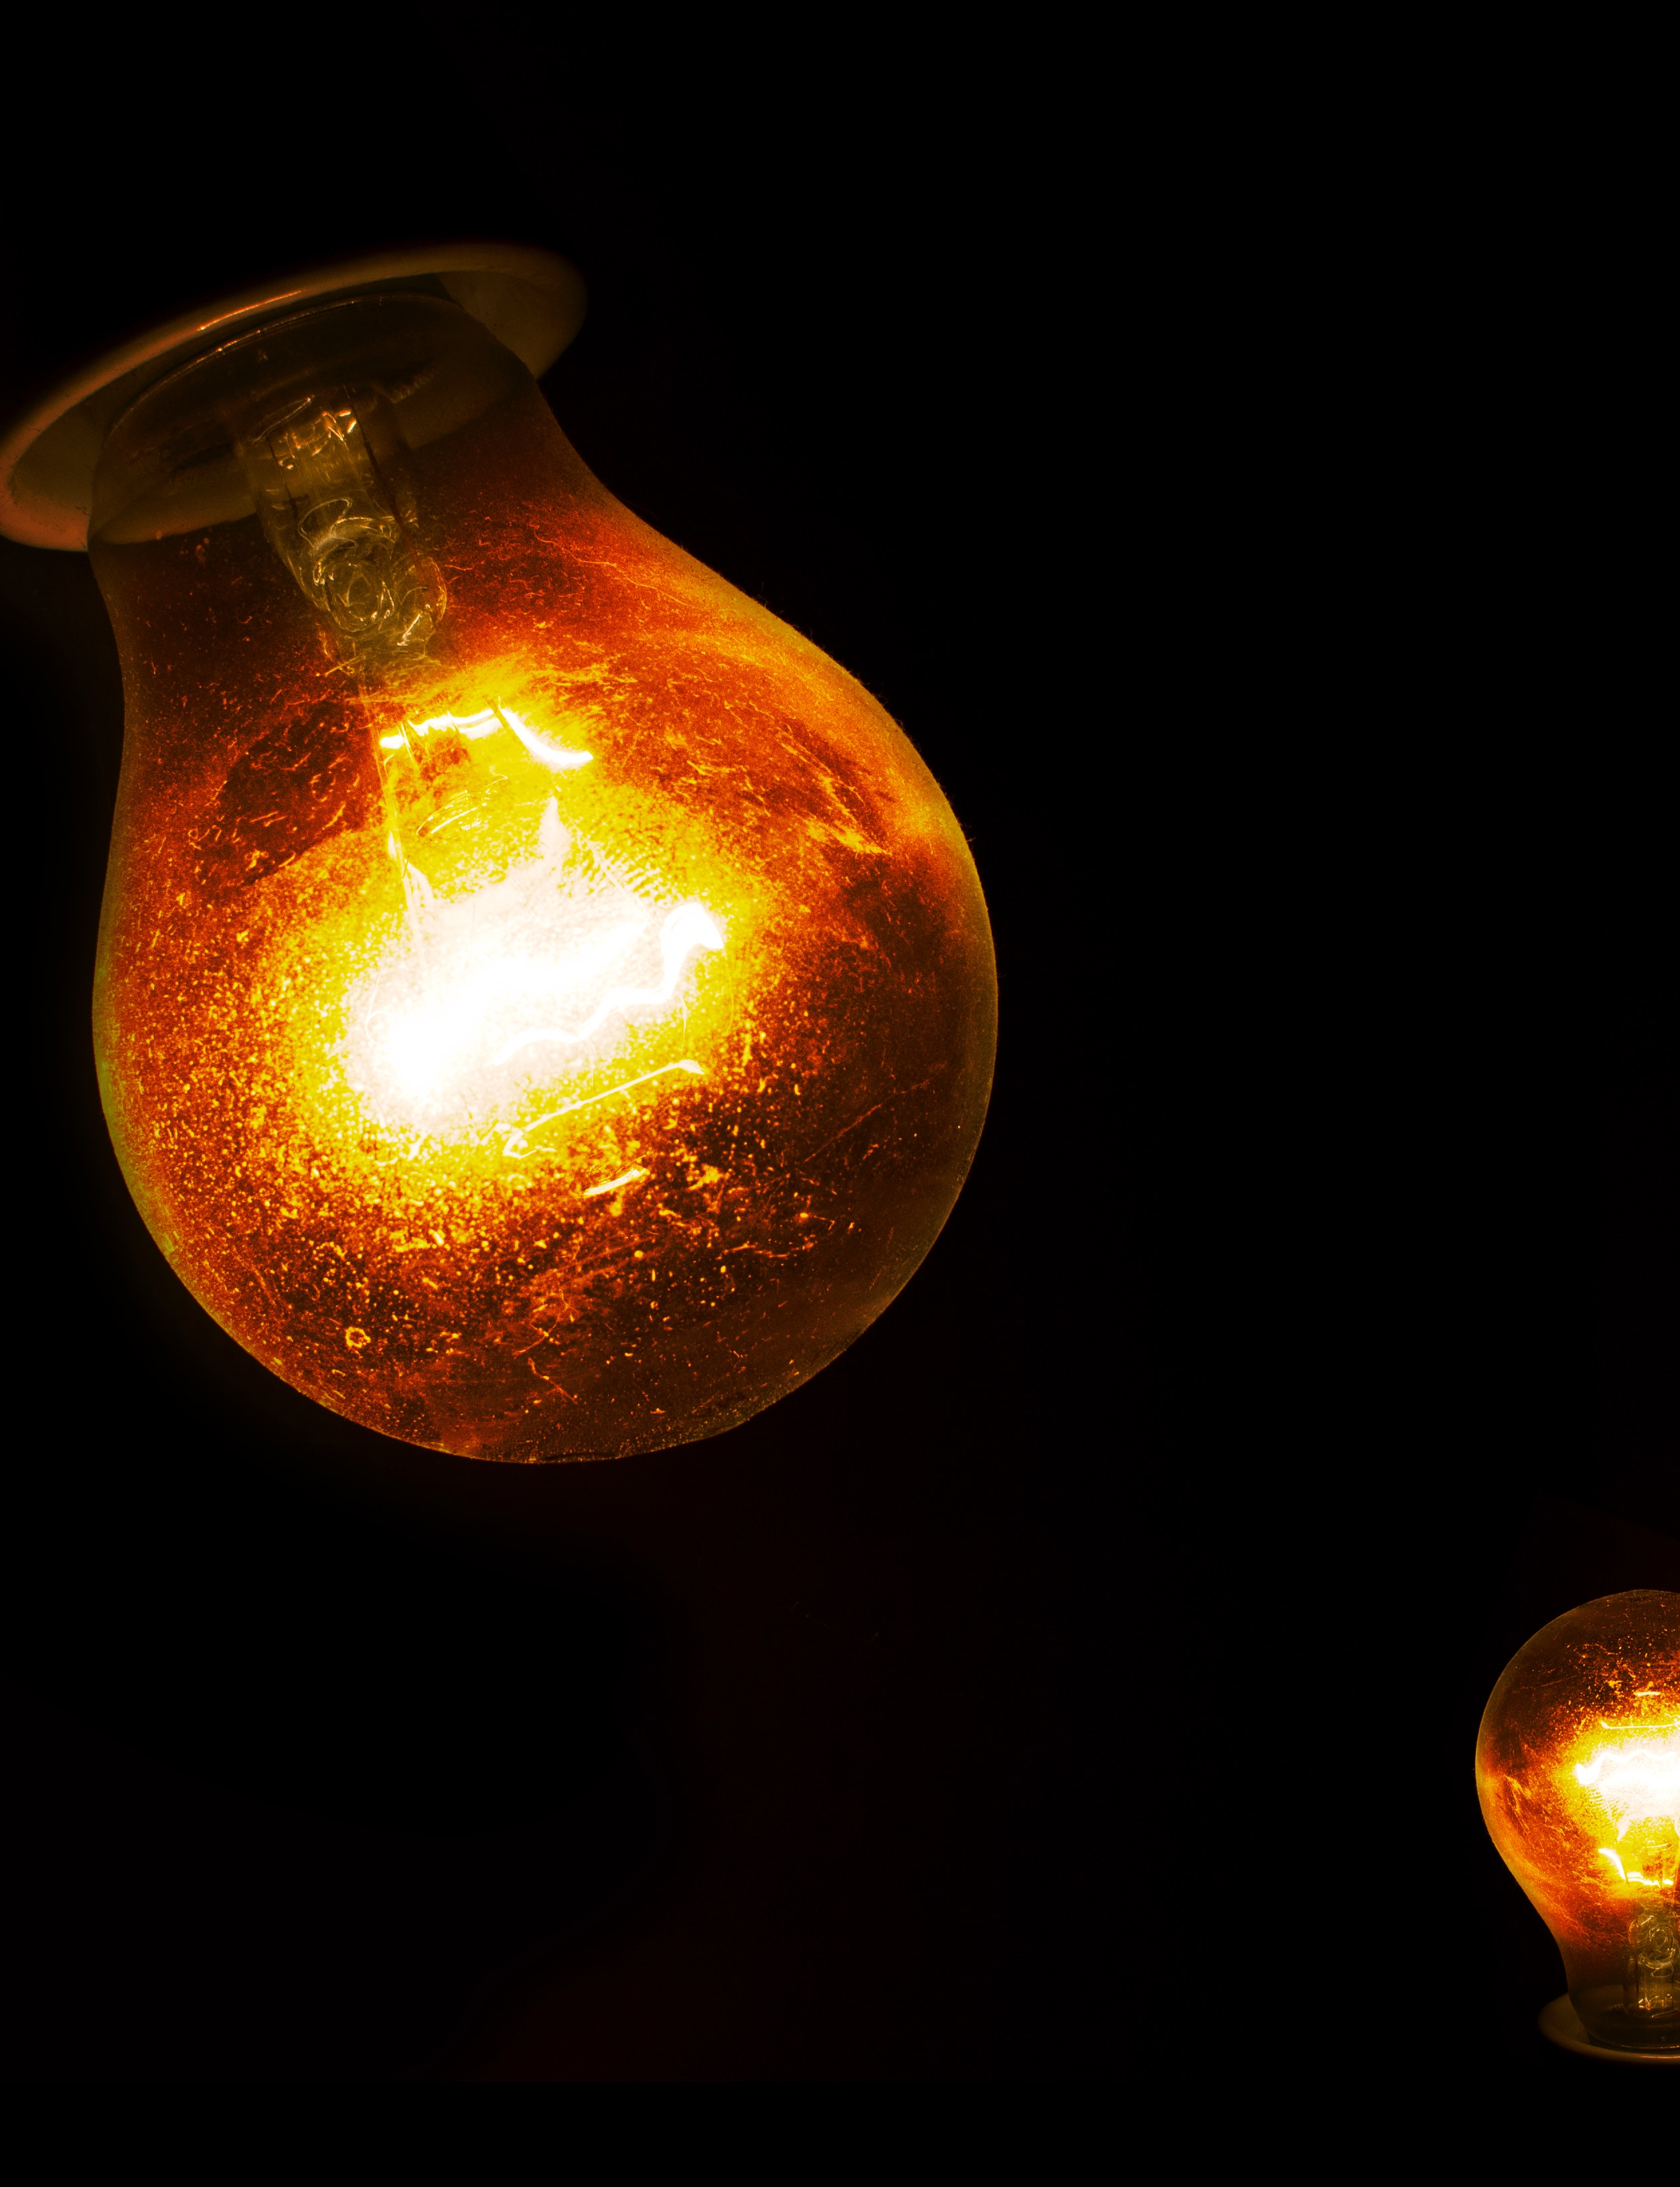

It is during our darkest moments that we must focus to see the light. – Aristotle
When you think light, think Lytle

Slide 4

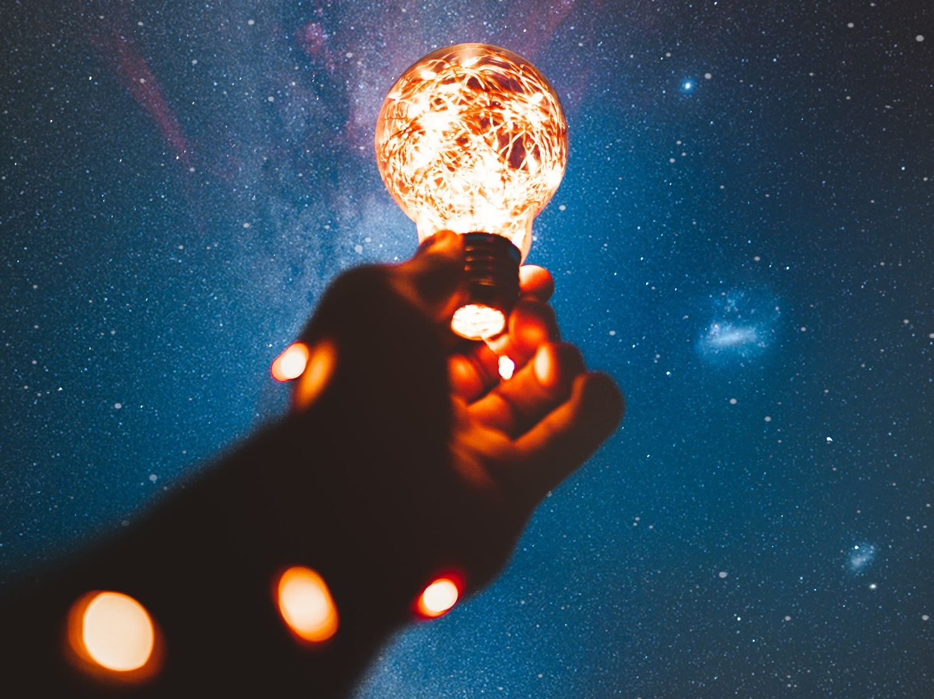



If you light a lamp for someone else, it will also brighten your path. -Buddha

Slide 5
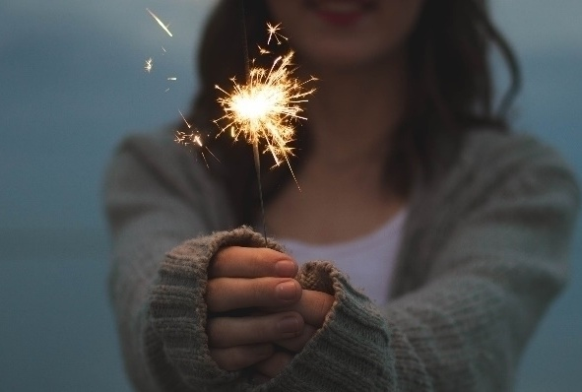



You have to find what sparks a light in you so that you in your own way can illuminate the world. -Oprah Winfrey
When you think light, think Lytle

Slide 6

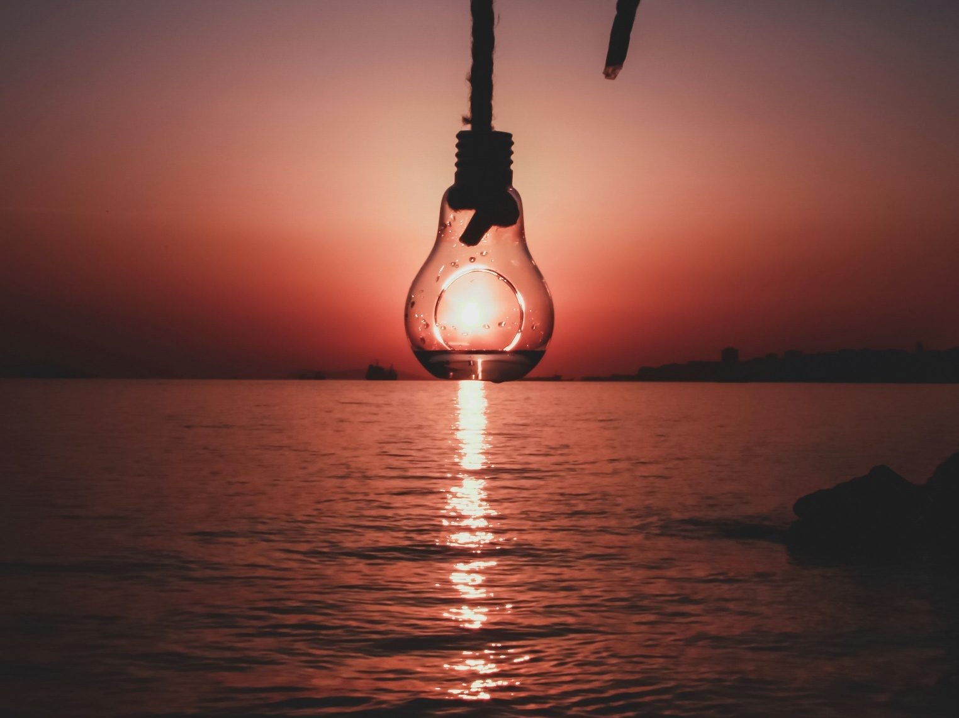

Be the beacon of light in someone’s darkness -Randy G. Fine

Slide 7
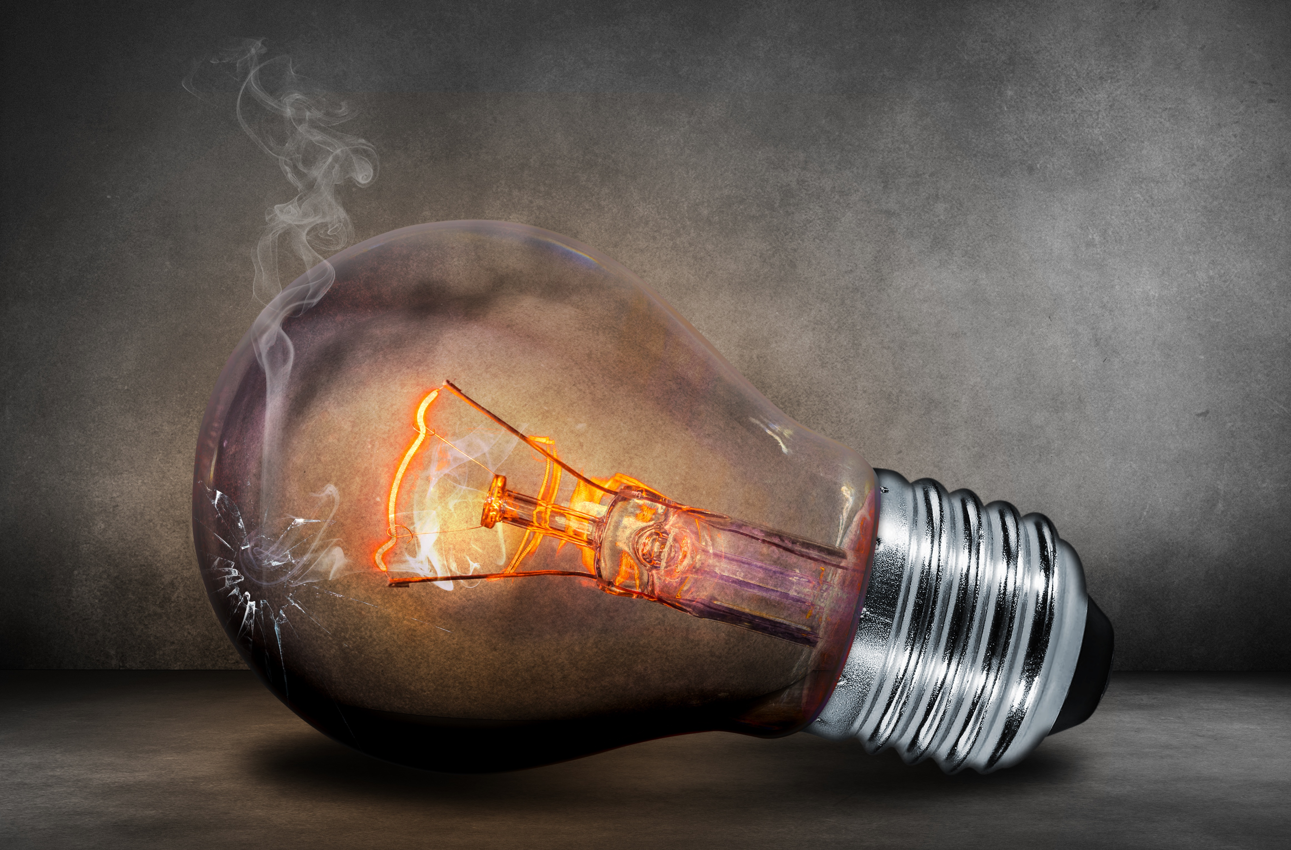
Darkness will always try to extinguish the light. The light will always try to repress the darkness. ― Morgan Rhodes
“
“
When you think light, think, Lytle

Slide 8


“Let your light shine. Shine within you so that it can shine on someone else. Let your light shine. “
– Oprah Winfrey

Slide 9


“The people who love you will guide you like bright lights into the other worlds.” ― Josephine Angelini

Slide 10
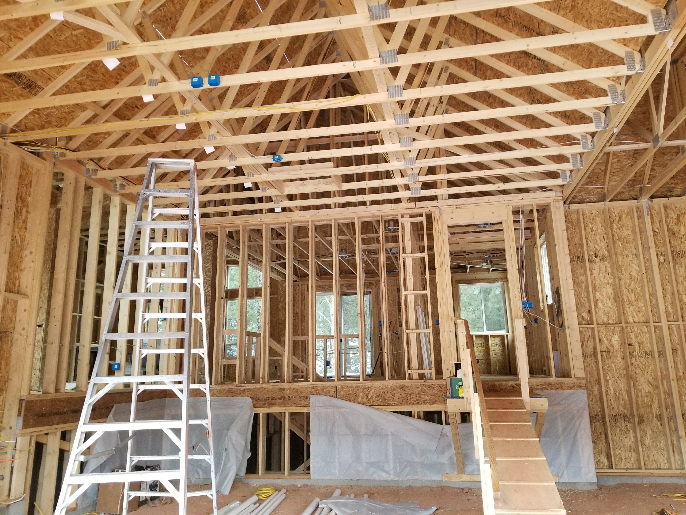
Regard it as just as desirable to build a chicken house as to build a cathedral. - Frank Lloyd Wright
We are like snowflakes, all different in our own beautiful way.
“

Slide 11


When you think Light,
THINK LYTLE

Slide 12

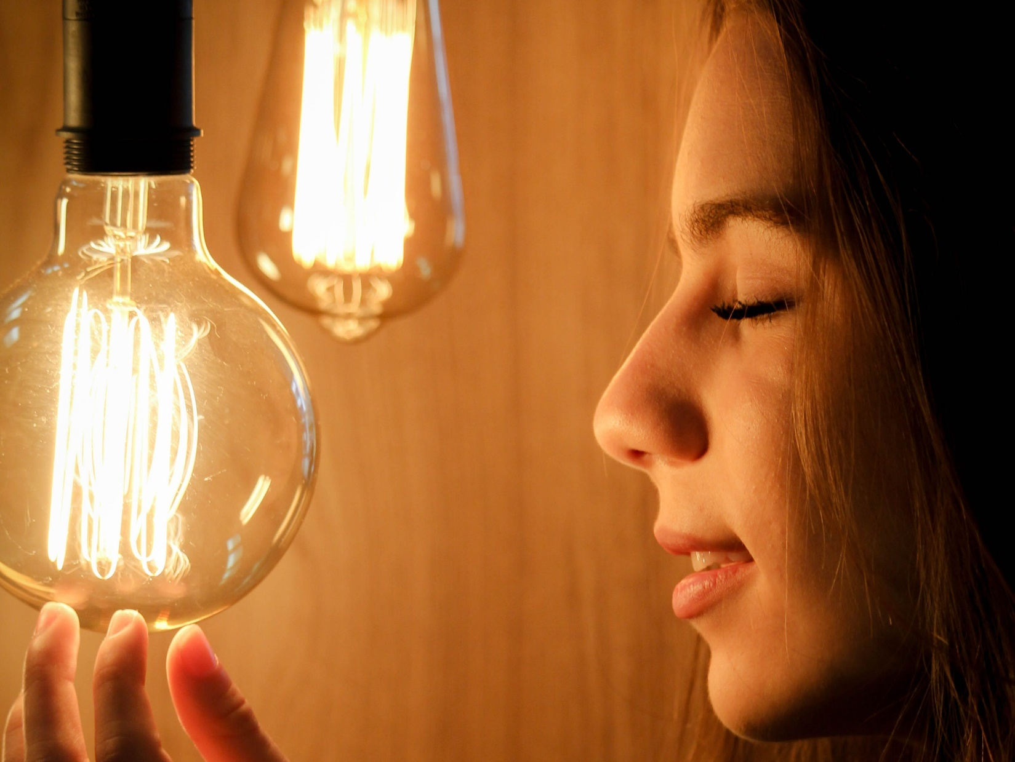


“As we work to create light for others, we naturally light our own way.” – Mary Anne Radmacher

Slide 13
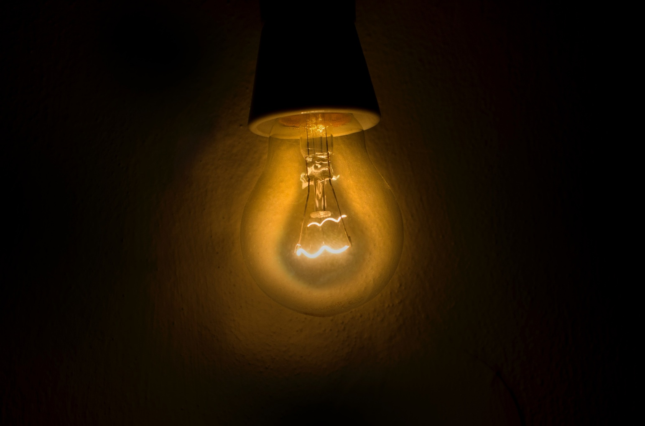


We’ve all got both light and dark inside us. What matters is the part we choose to act on. That’s who we really are.
– J. K. ROWLING

Slide 14
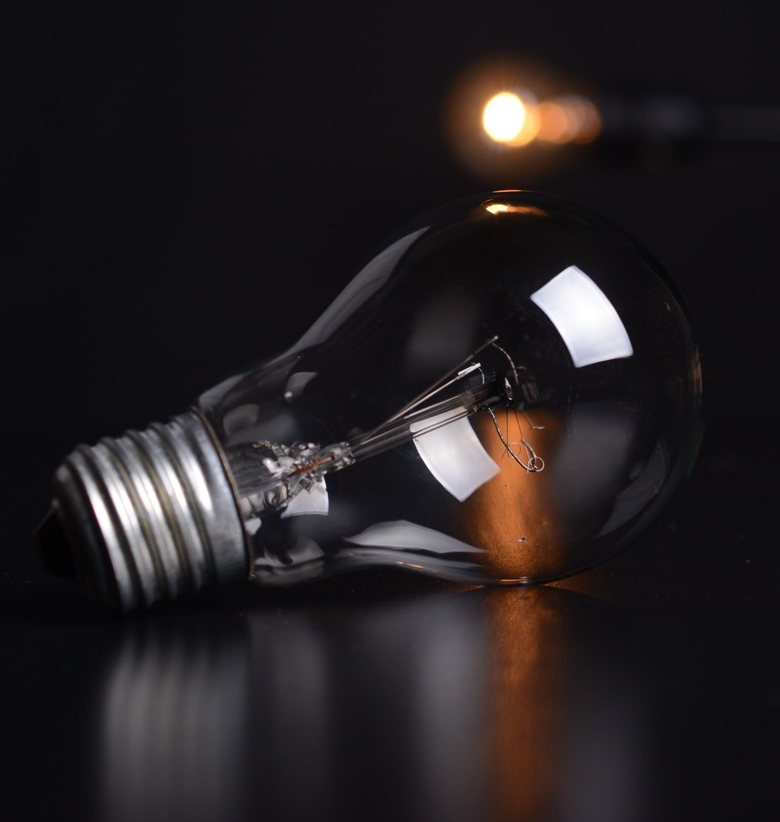

“Life isn’t just about darkness or light, rather it’s about finding light within the darkness.”
― Landon Parham

Slide 15
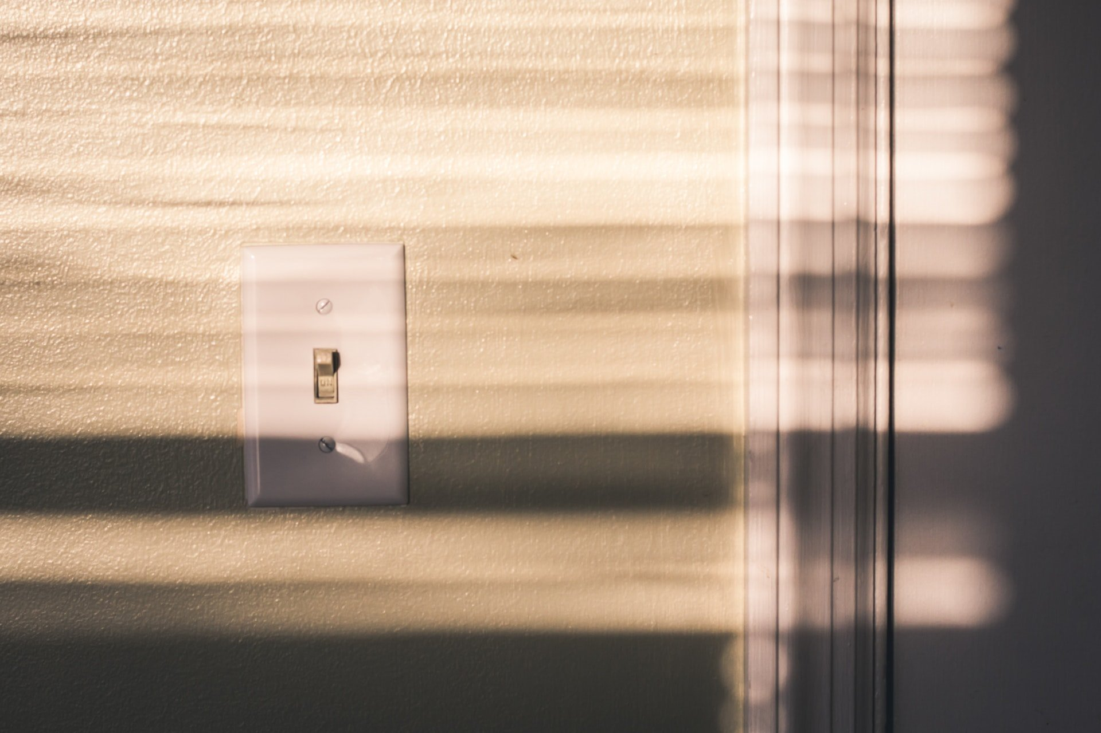

“Most of us are imprisoned by something. We’re living in darkness until something flips on the switch.” ― Wynonna Judd
When you think light, think Lytle

Slide 16
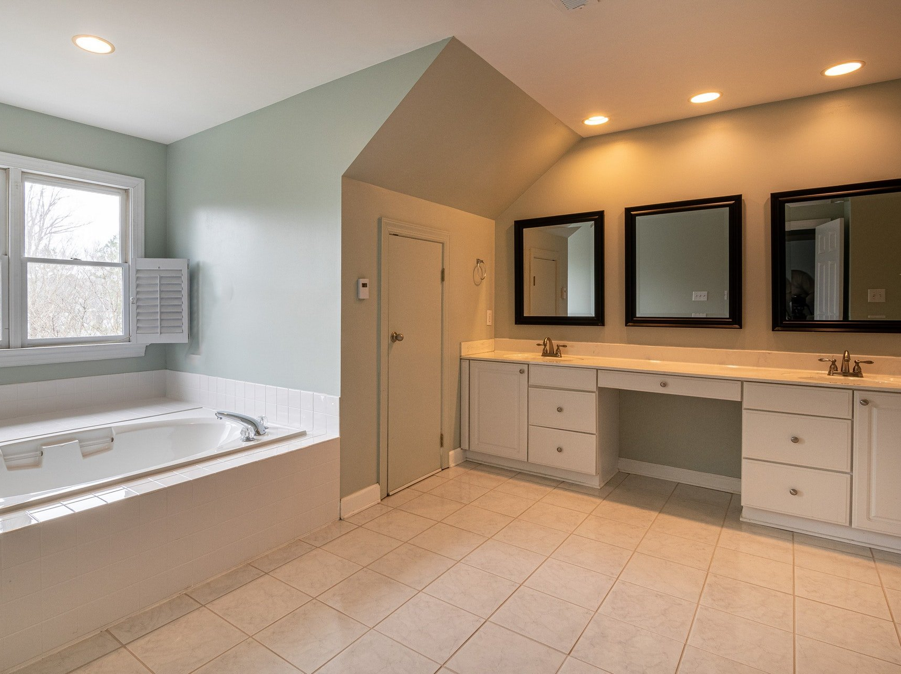
Lighting Is Everything. It Creates Atmosphere, Drama, And Intrigue In A Room. The Easiest Way To Accomplish This Is With A Dimmer Switch. I Always Use Dimmers, Even In The Powder Room!
Martyn Lawrence Bullard

Slide 17
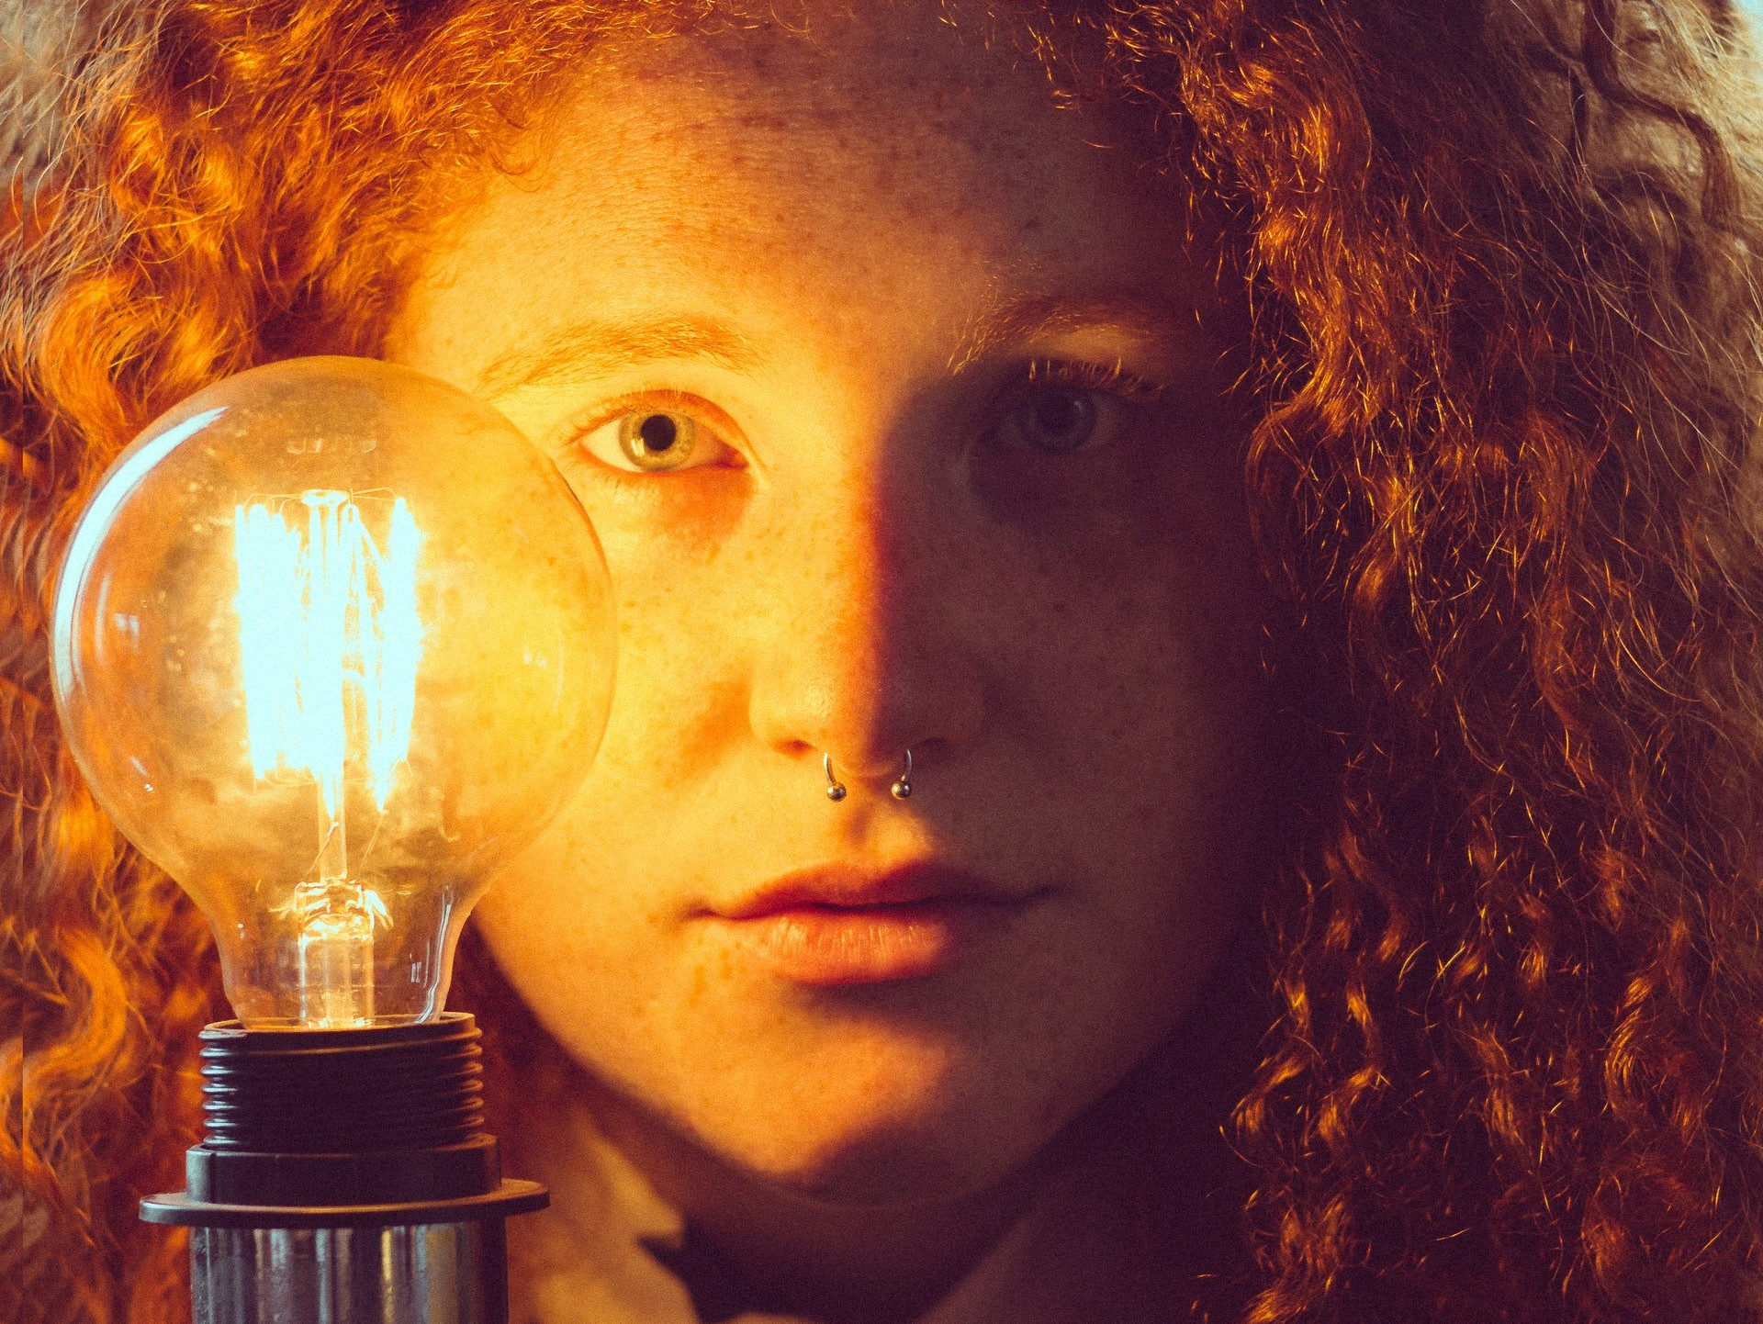
See the light in others and treat them as if that is all you see.
Dr. Wayne Dyer

Slide 18
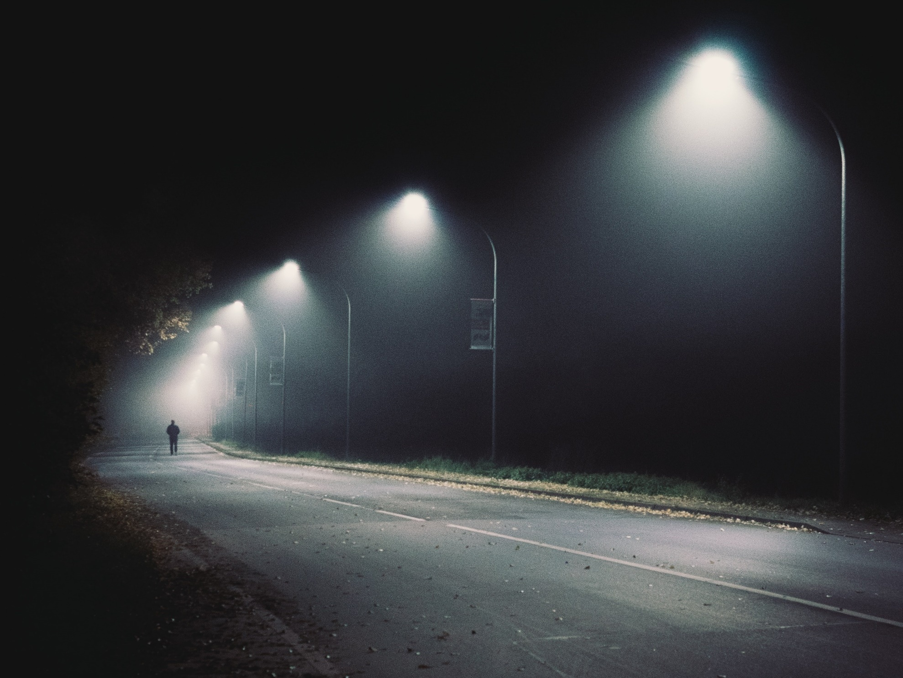
Wherever you go, leave a trail of light
Susan Rohrer

Slide 19
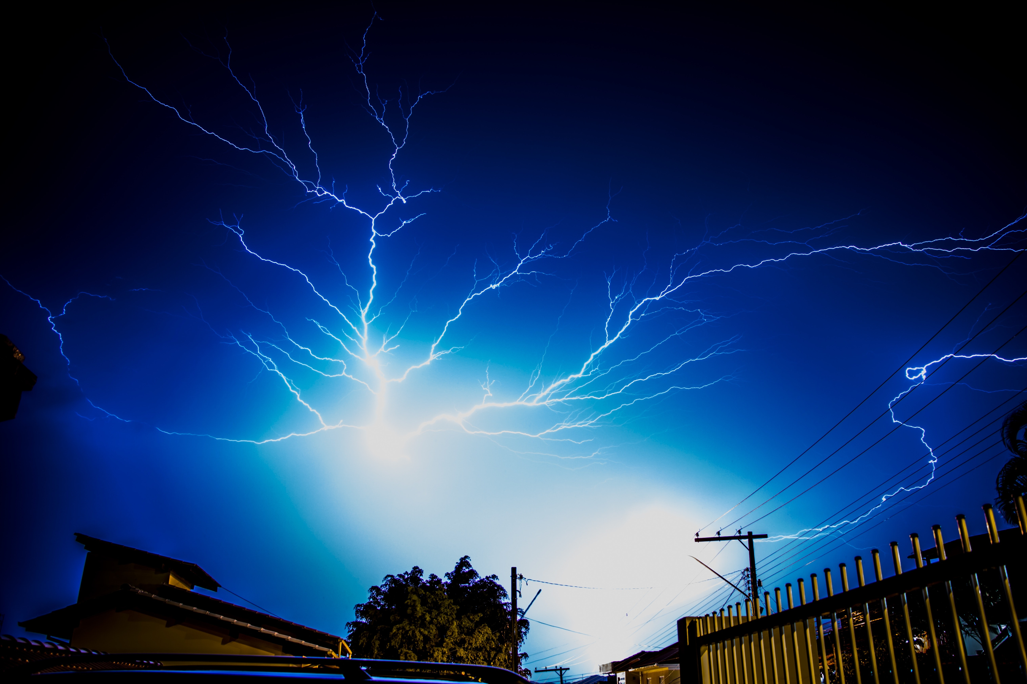
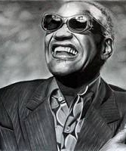

What is soul? It’s like electricity- we don’t’ really know what it is, but it’s a force that can light a room.
Ray Charles
This Photo by Unknown Author is licensed under CC BY-ND

Slide 20
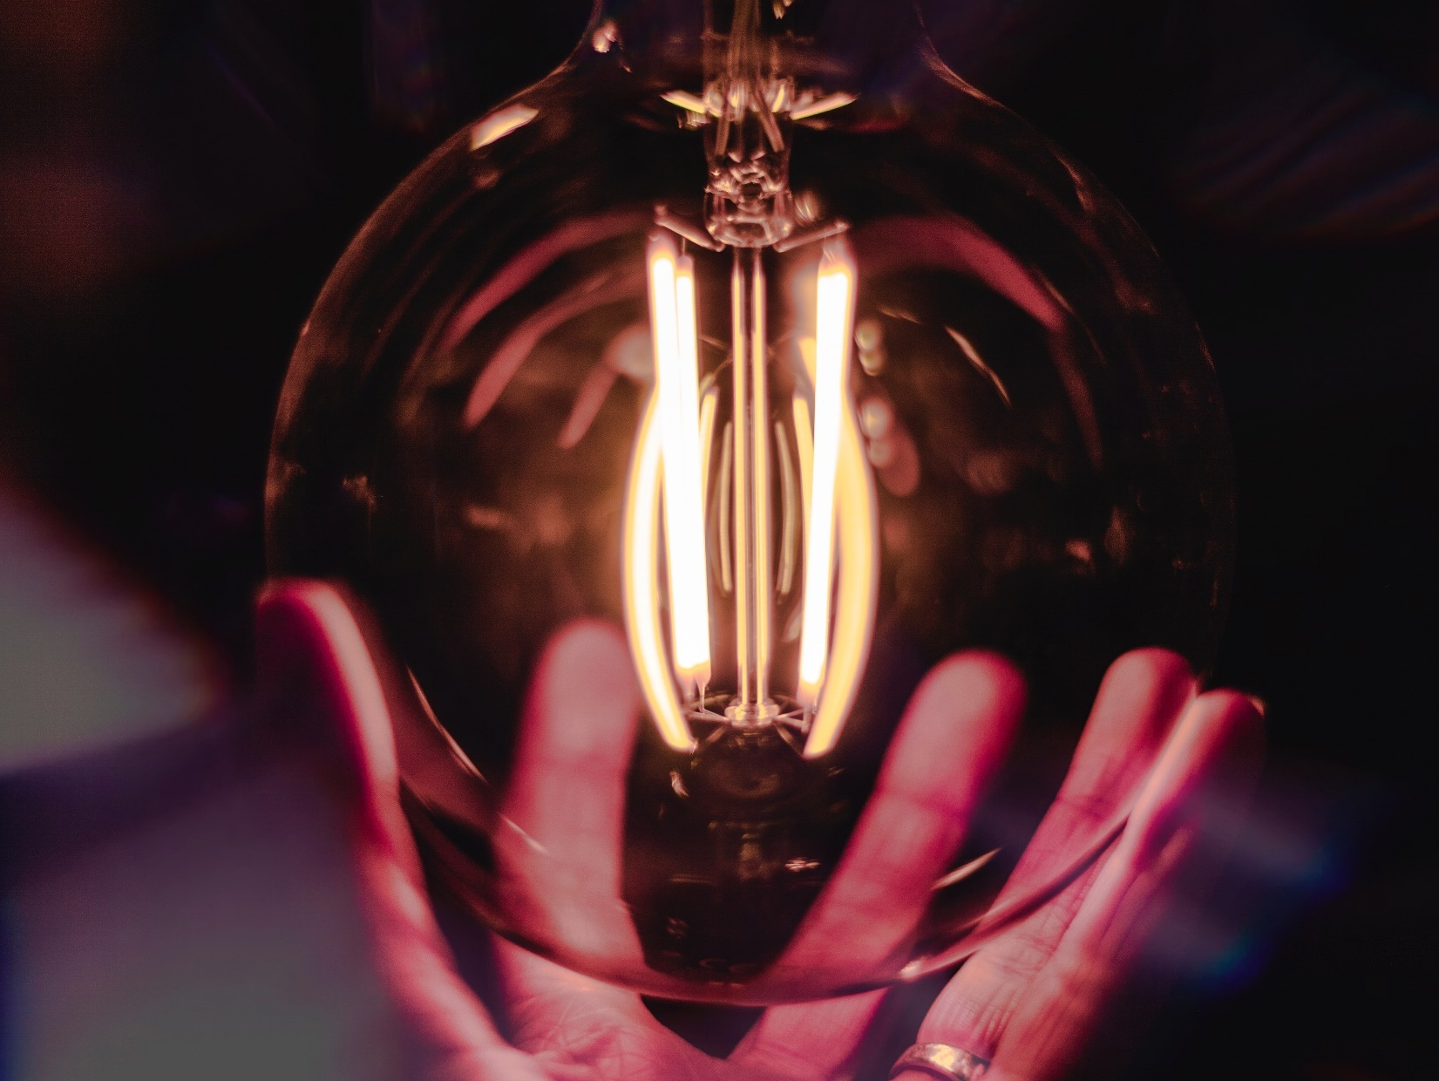

Happiness can be found, even in the darkest of times, if one only remembers to turn on the light -Albus Dumbledore

Slide 21


Relationships are like electric currents, wrong connection will give you a shock throughout your life, but the right one will light up your life.

Slide 22

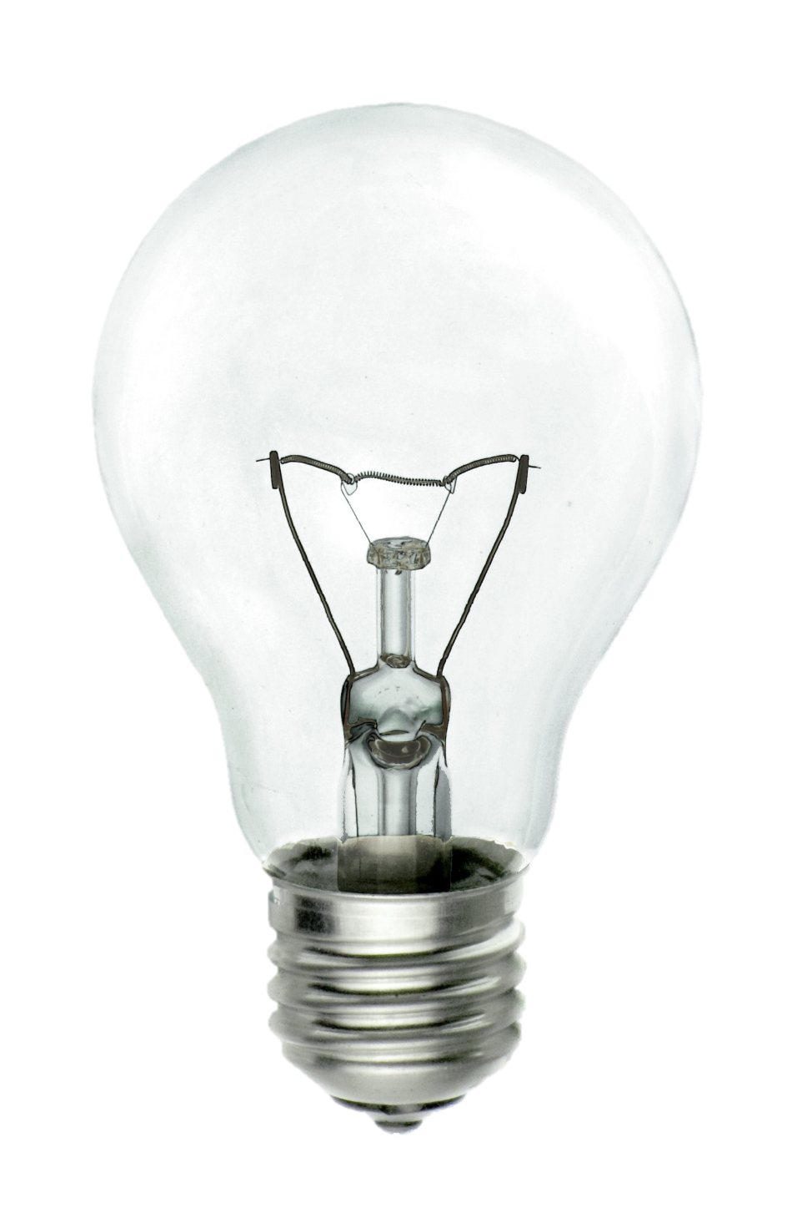
If you can dream it, you
CONDUIT!

Slide 23

Let nothing dim the light that shines from within.
Shine on
Maya Angelou

Slide 24


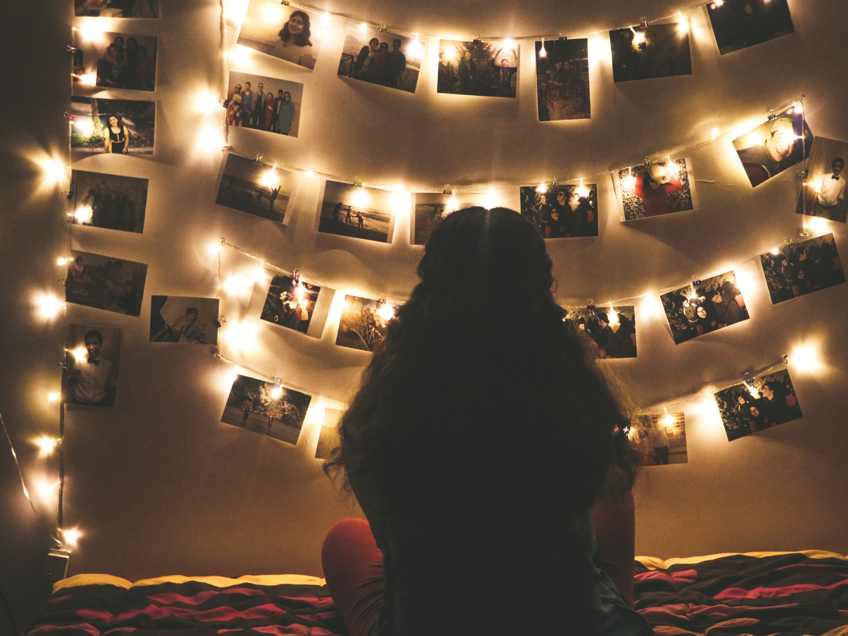


You were born to light up the world

Slide 25


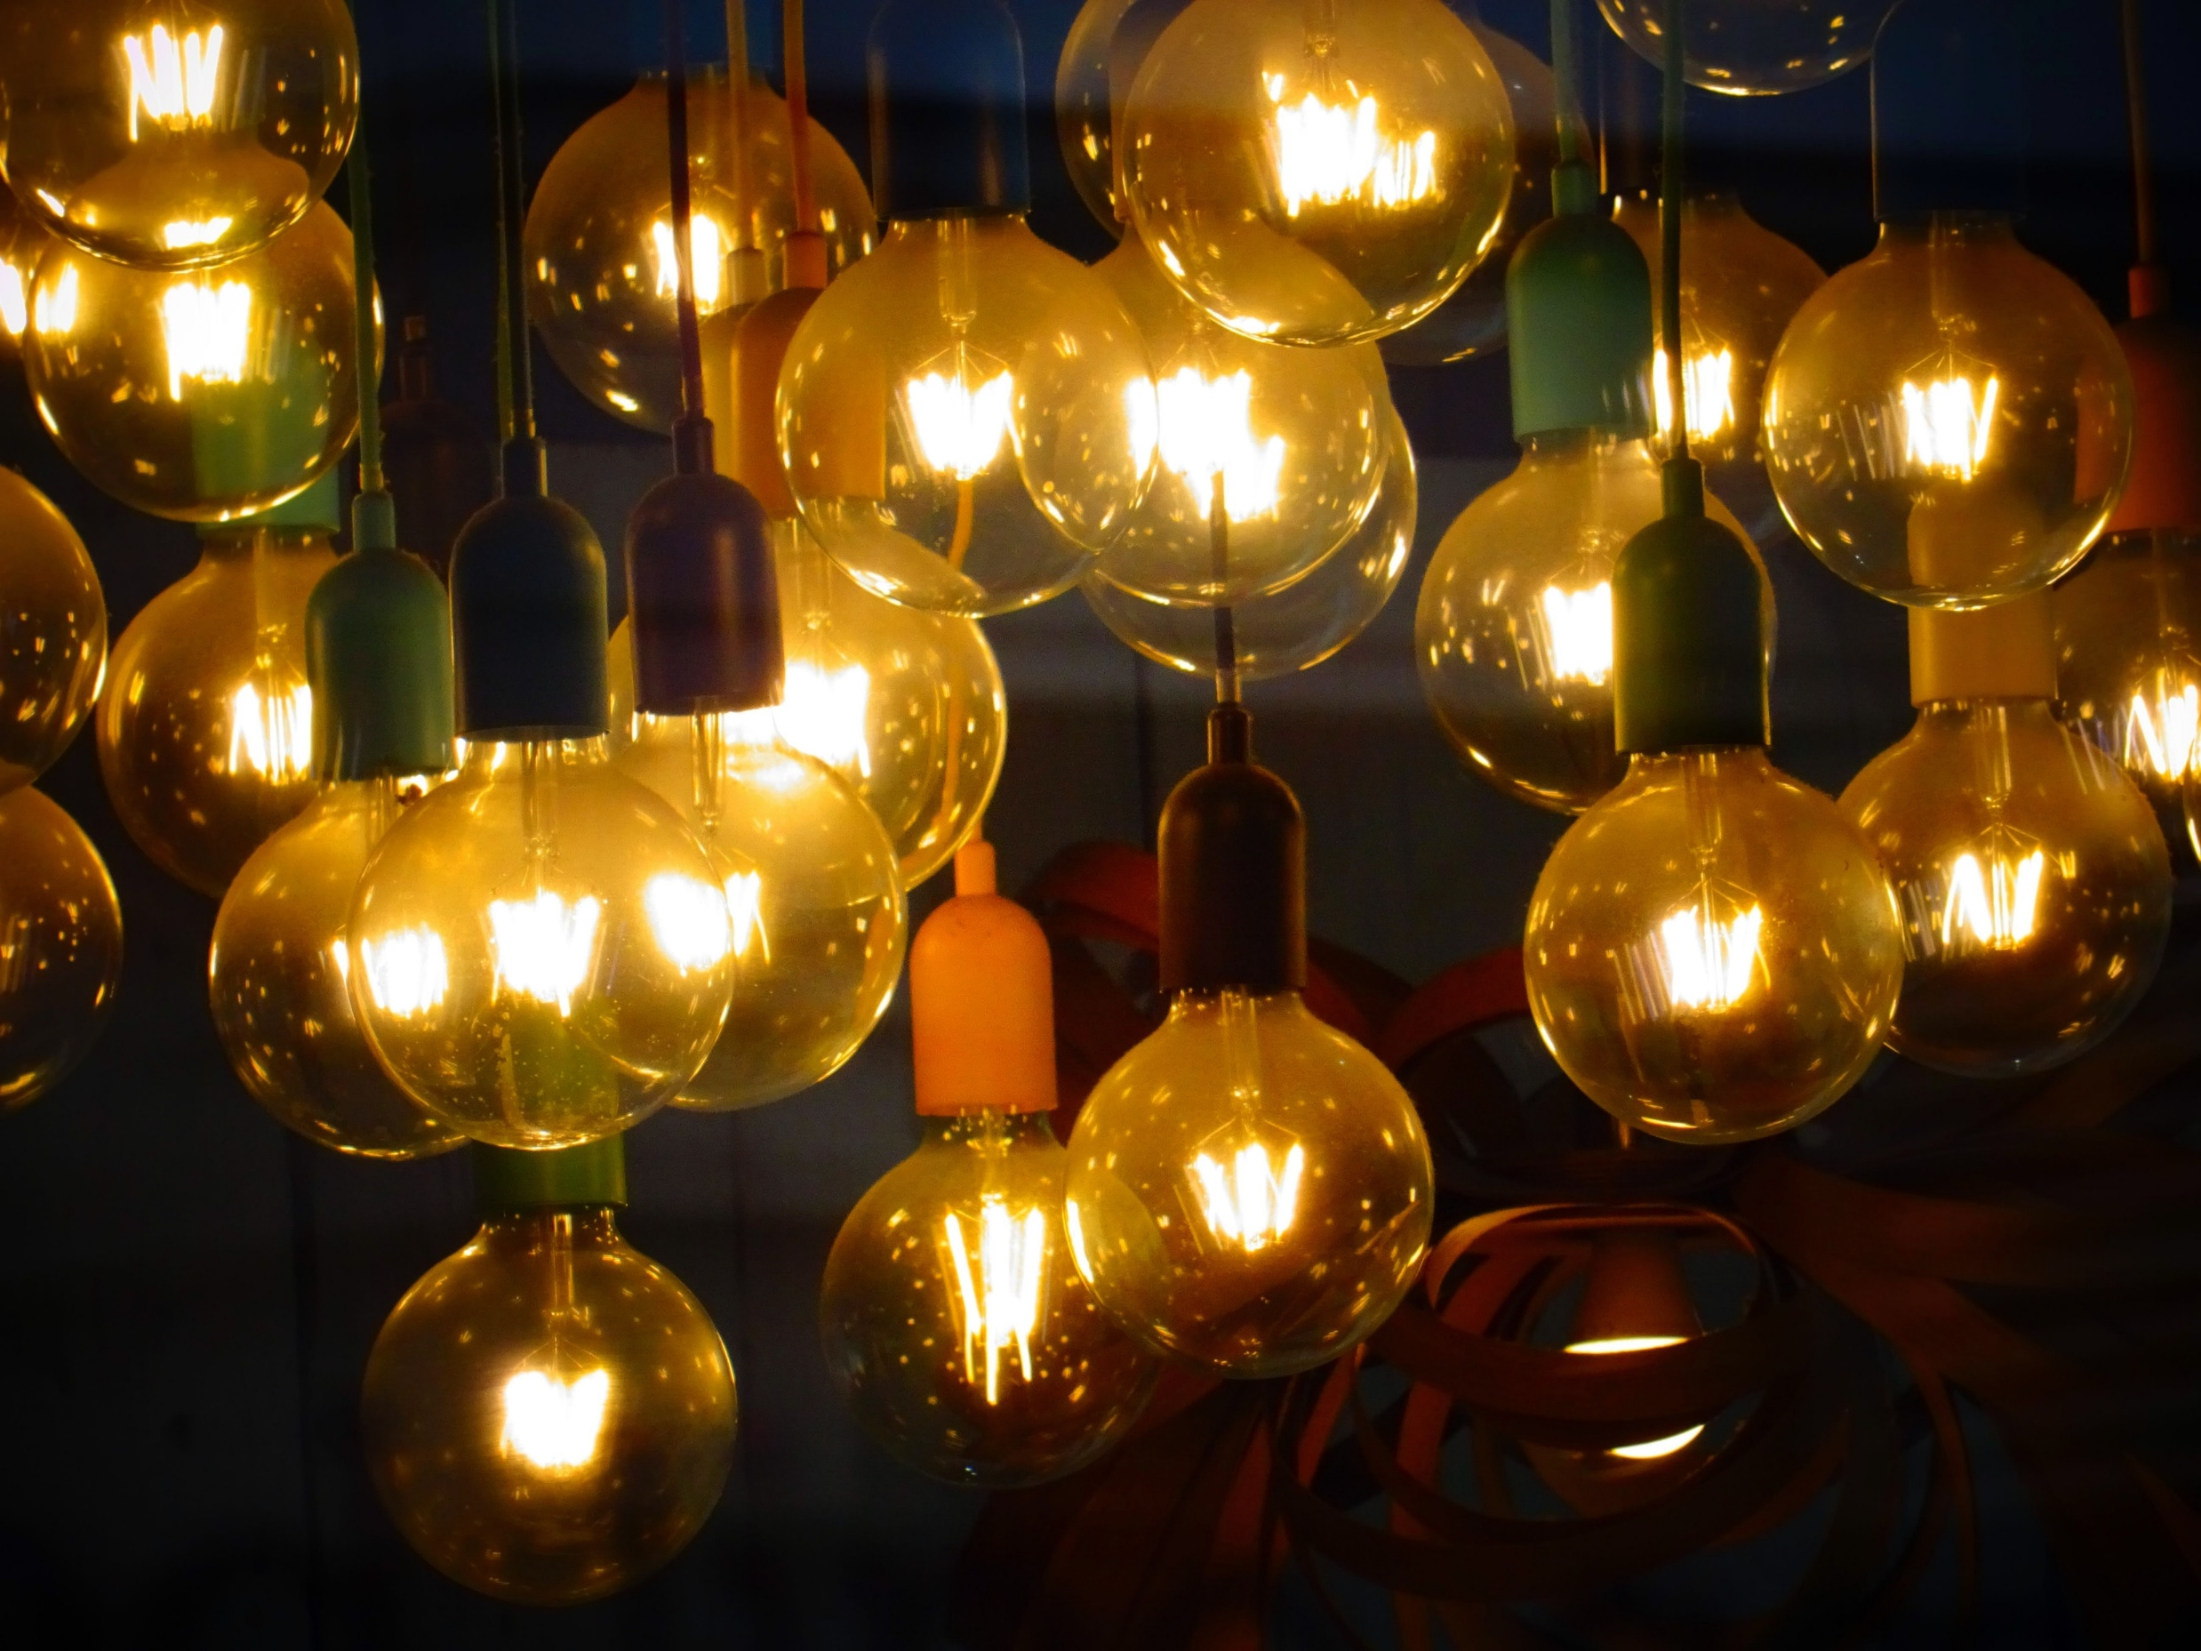



Faith is like electricity. You can’t see it, but you can see the light.
When you think light, think Lytle

Slide 26

Gratitude is a quality similar to electricity: it must be produced and discharged and used up in order to exist at all
William Faulkner

Slide 27



I will love the light for it shows me the way. Yet I will endure the darkness for it shows me the stars.
-OG Mandino

Slide 28
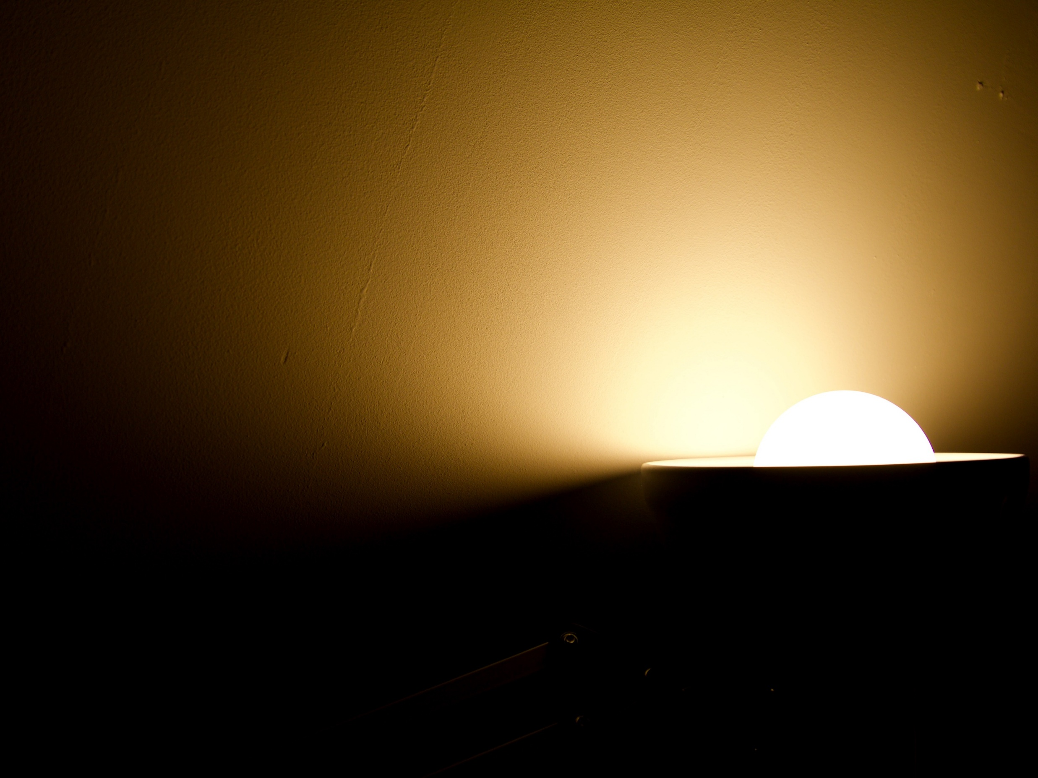

Only when we are brave enough to explore the darkness will we discover the infinite power of our light -Brene Brown

Slide 29
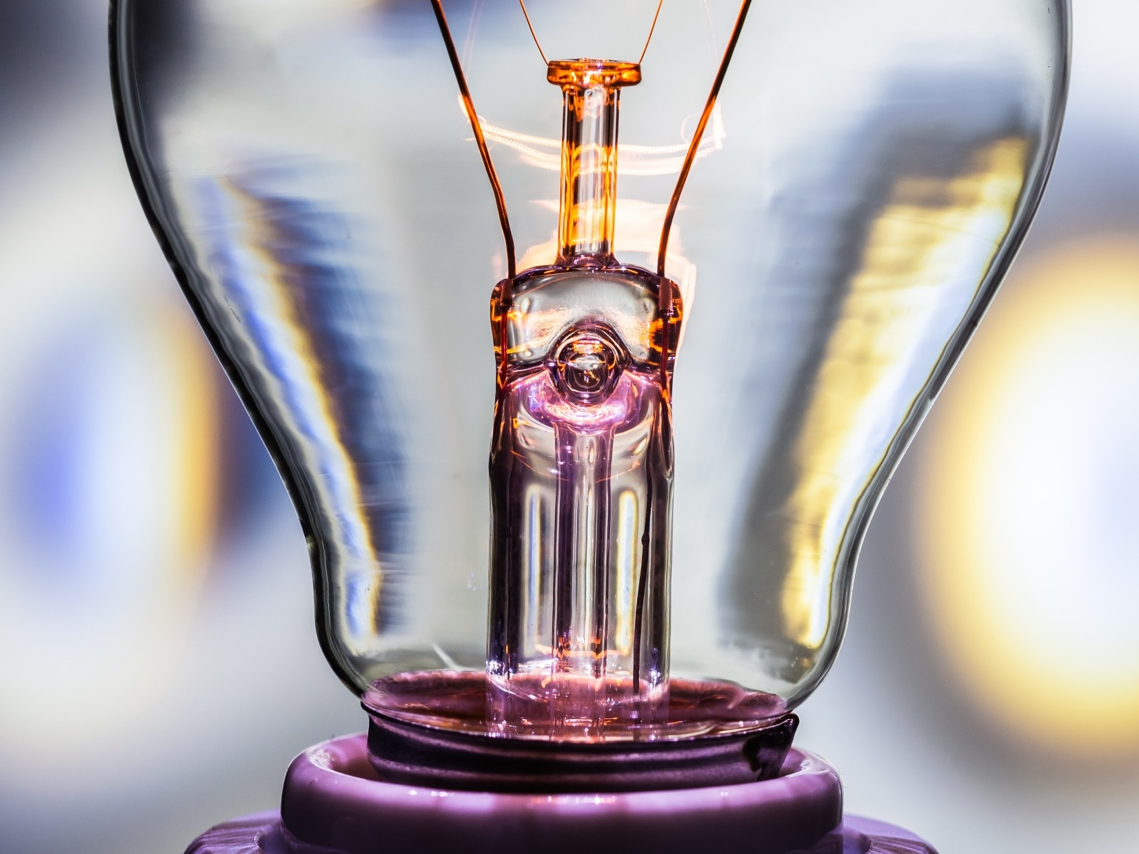
Travel light. Live light. Spread the light. Be the light.

Slide 30
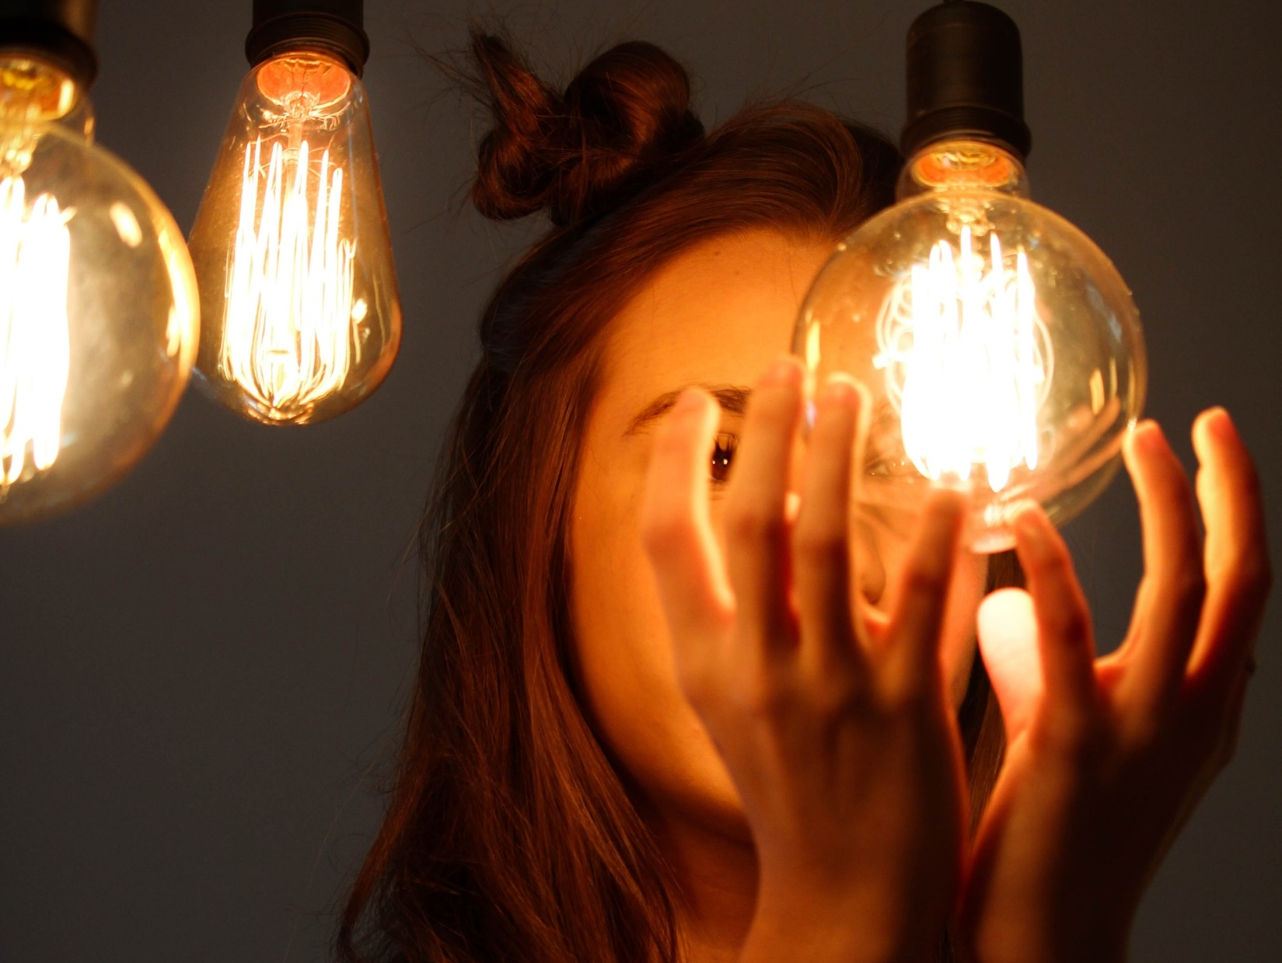
The same light you see in others is shining within you, too. -MHN

Slide 31
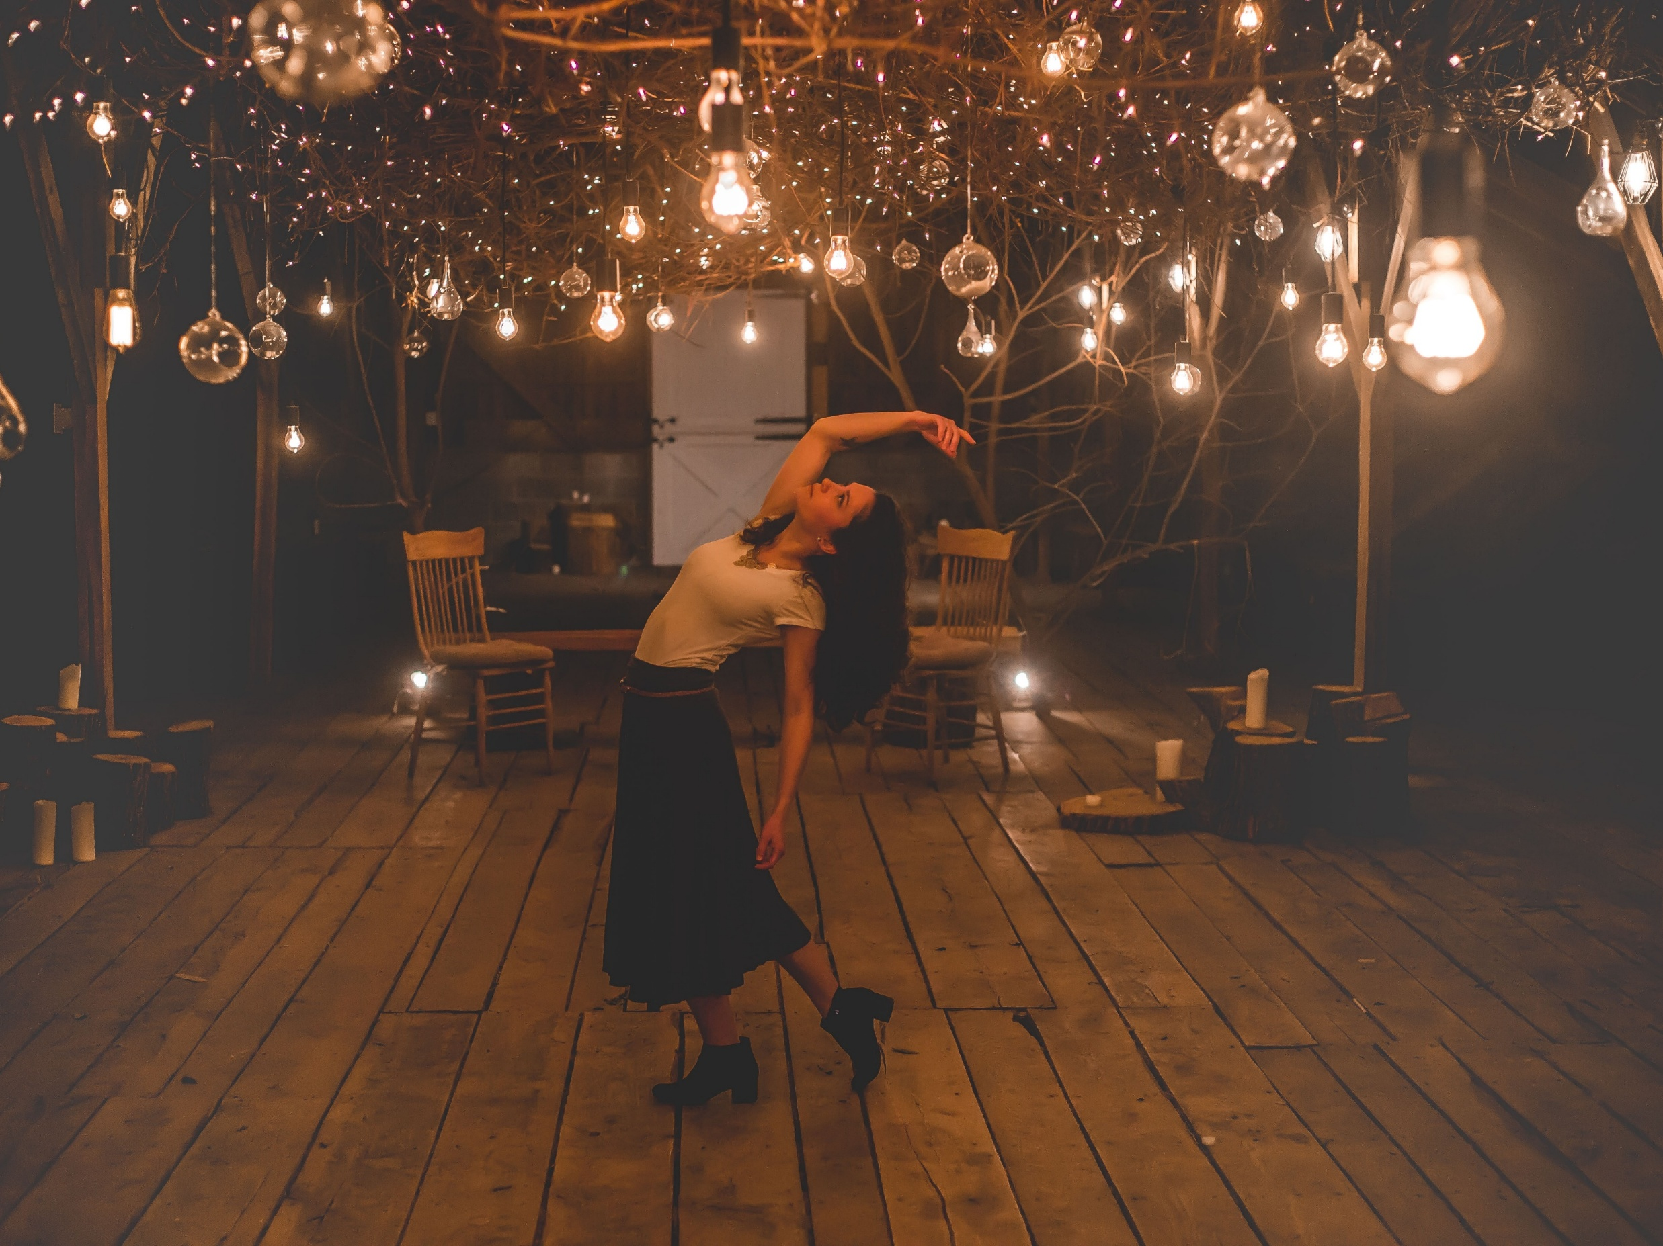
When you possess light within, you see it externally. -Anas Nin

Slide 32
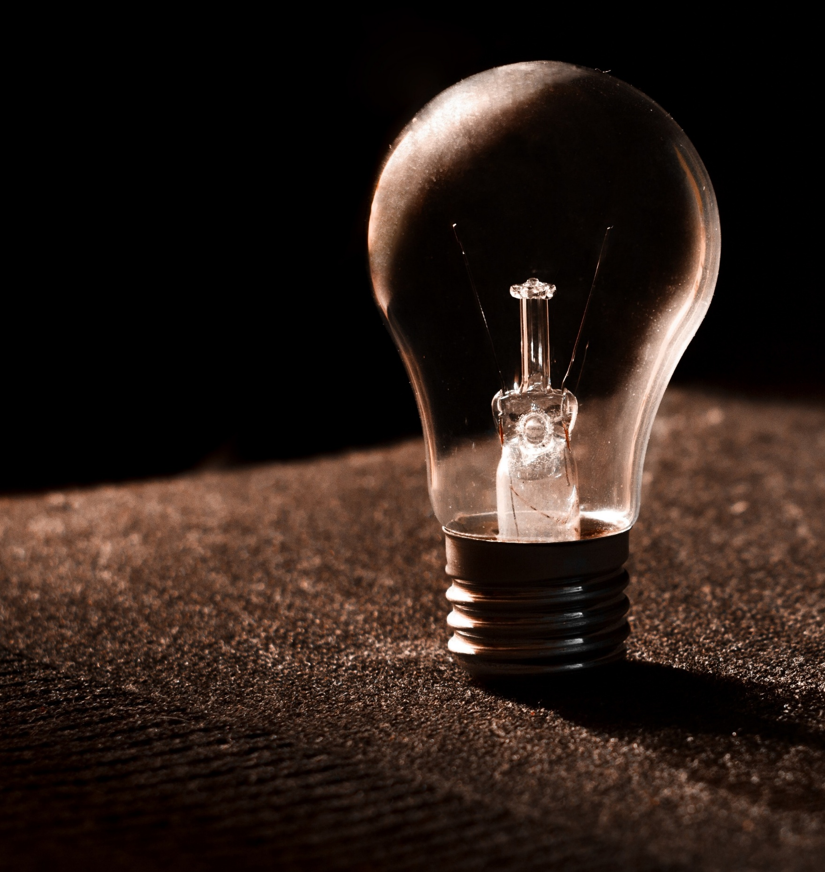


We are all broken. That’s how the light gets in. -Ernest Hemingway

Slide 33
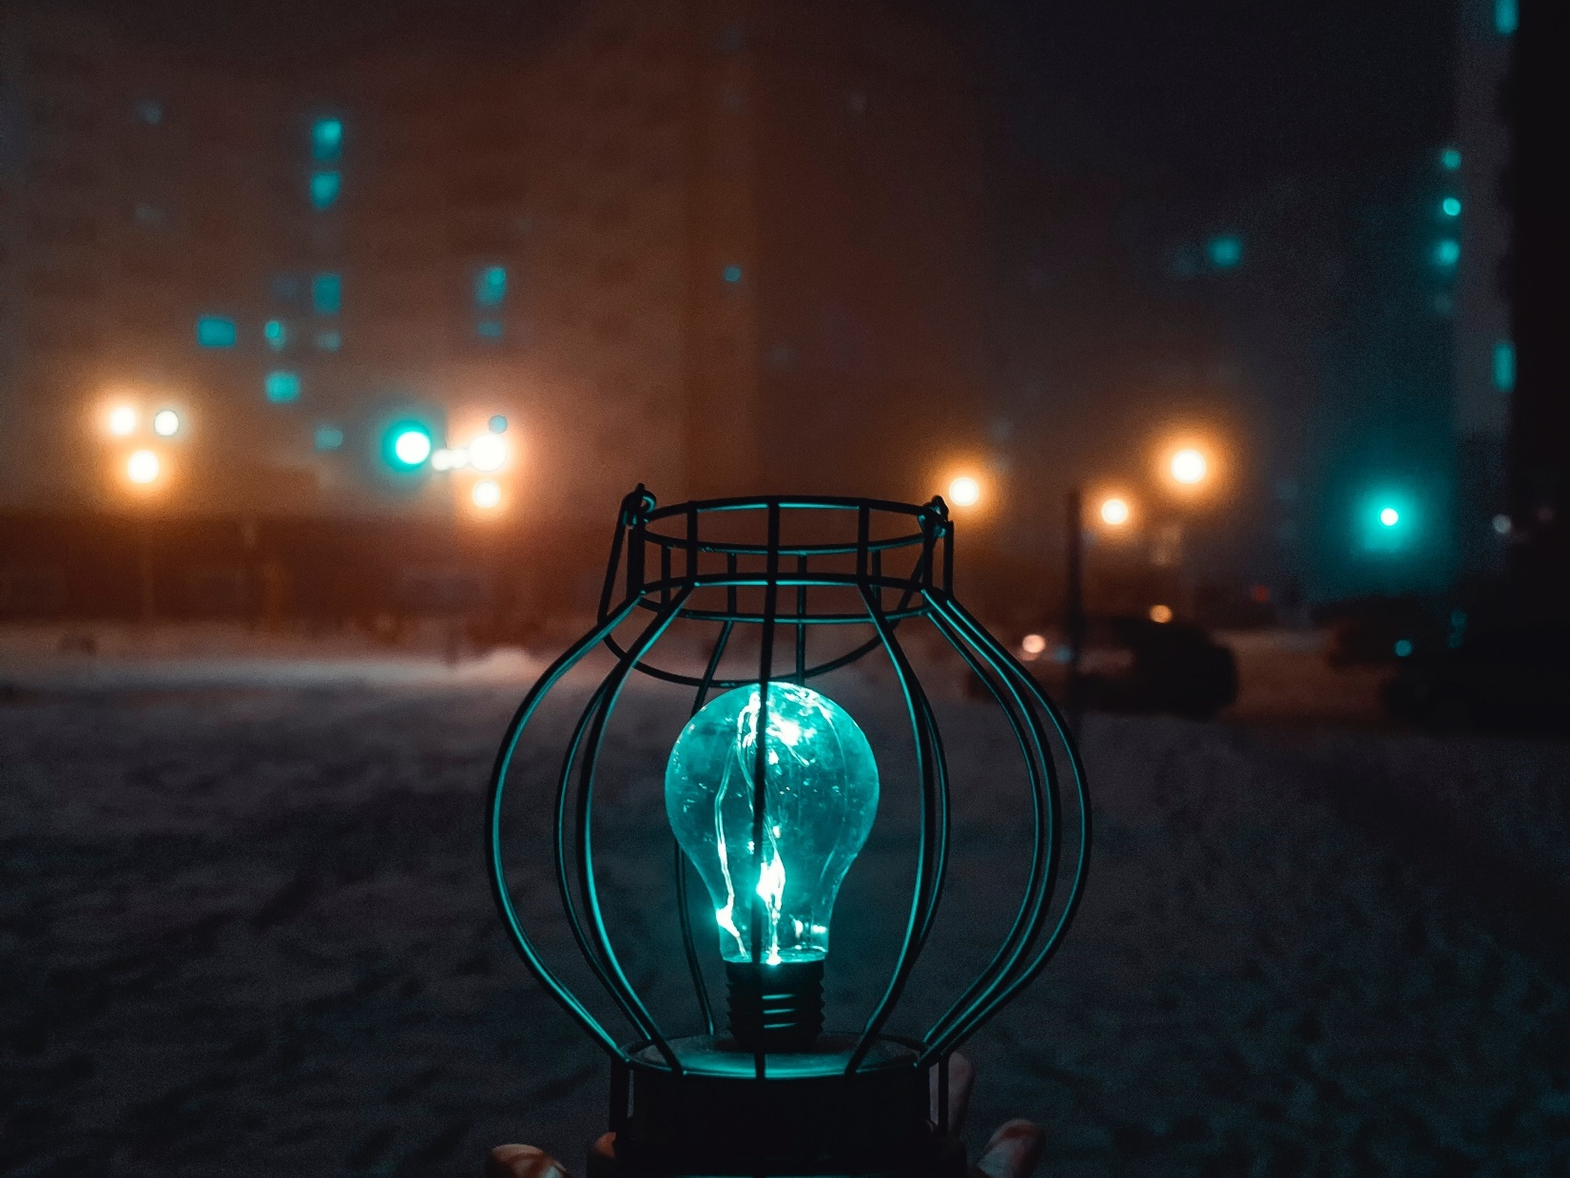


The beauty of the light owes its existence to the dark. -Brene Brown

Slide 34



At times, our own light goes out and is rekindled by a spark from another person. Each of us has cause to think with deep gratitude of those who have lighted the flame within us. -Albert Schweitzer

Slide 35
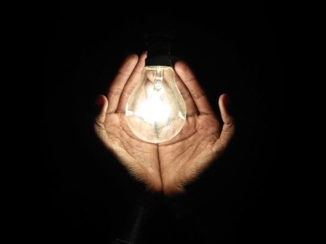


There is no darkness so dense, so menacing, or so difficult that it cannot be overcome by the light.
-Vern P. Stanfill

